Slide 1

NBA Player Types and Optimal Lineup Composition Mark Corey github.com/MarkDCorey/nba_player_clustering
Notes:
What
Big basketball fan, decided to explore whether...
NBA Players can effectively clustered into types based
If so:
Can we apply these clusters to the task of finding optimal lineups.
Lineups are groups players from same team who play on the court together.
context 20-30 sec
process 1 min
results 1-1.5min
next steps 20-30 sec
2 min for questions

Slide 2
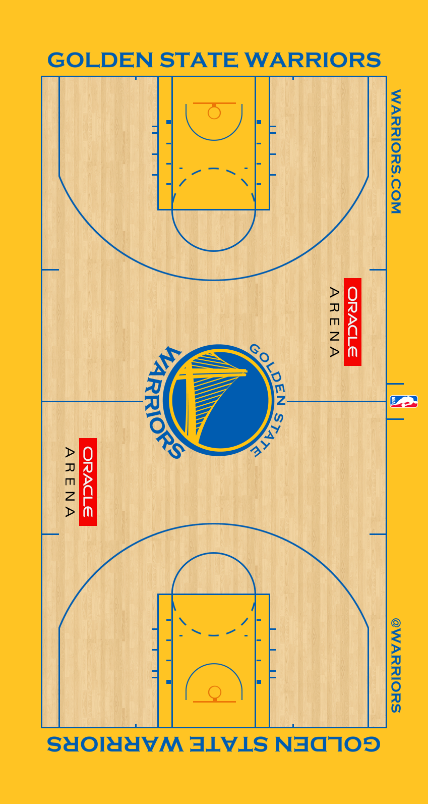
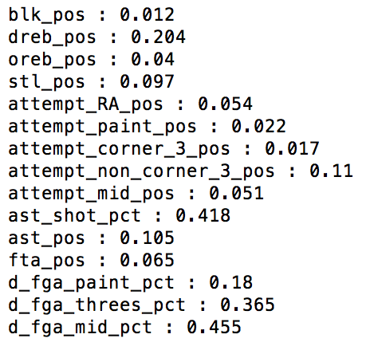
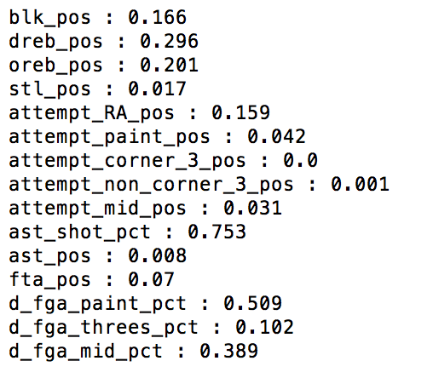
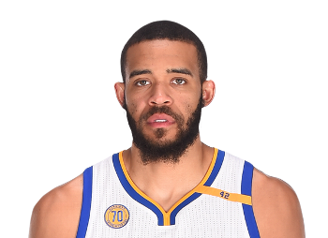
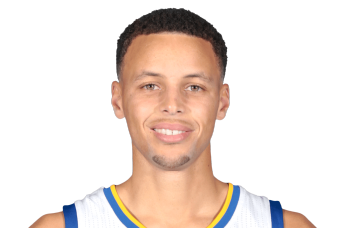
Player Data Example
Notes:
WHERE DID THE DATA COME FROM
I scraped player performance statistics data from NBA/stats.com for all players since the 2013-14 season (750), reduced this set to those who played above 200 min (600)
DESCRIBE FEATURES
1) Created 15 features – player statistics standardized to per-posession to control for playing time and pace of play.
2) Try to balance defensive and offensive features to the extent possible. Defense is half the game but there aren’t many defensive stats captured compared to offensive.
3) Capture actions taken on the court rather than efficiency of those actions bc I have a low ratio of observations to features
Steph Curry --> shoots a lot of threes, plays his defense on the perimeter
Javale McGee --> almost everything he contriubutes, on offense and defense occurs close to the basket.

Slide 3
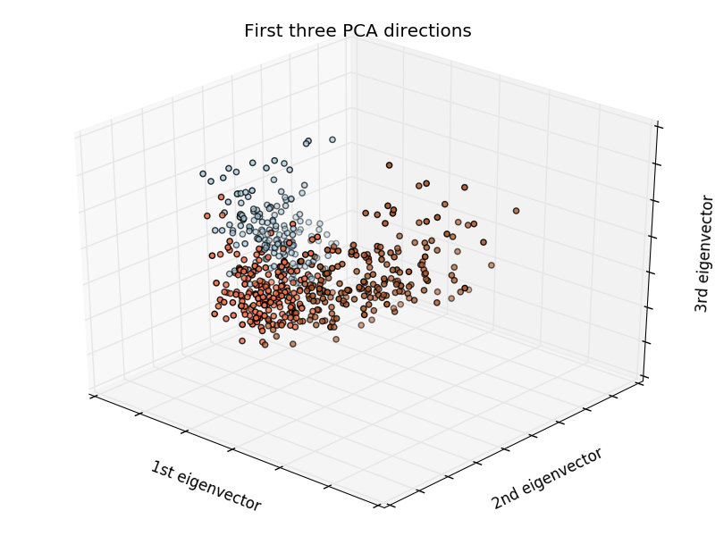
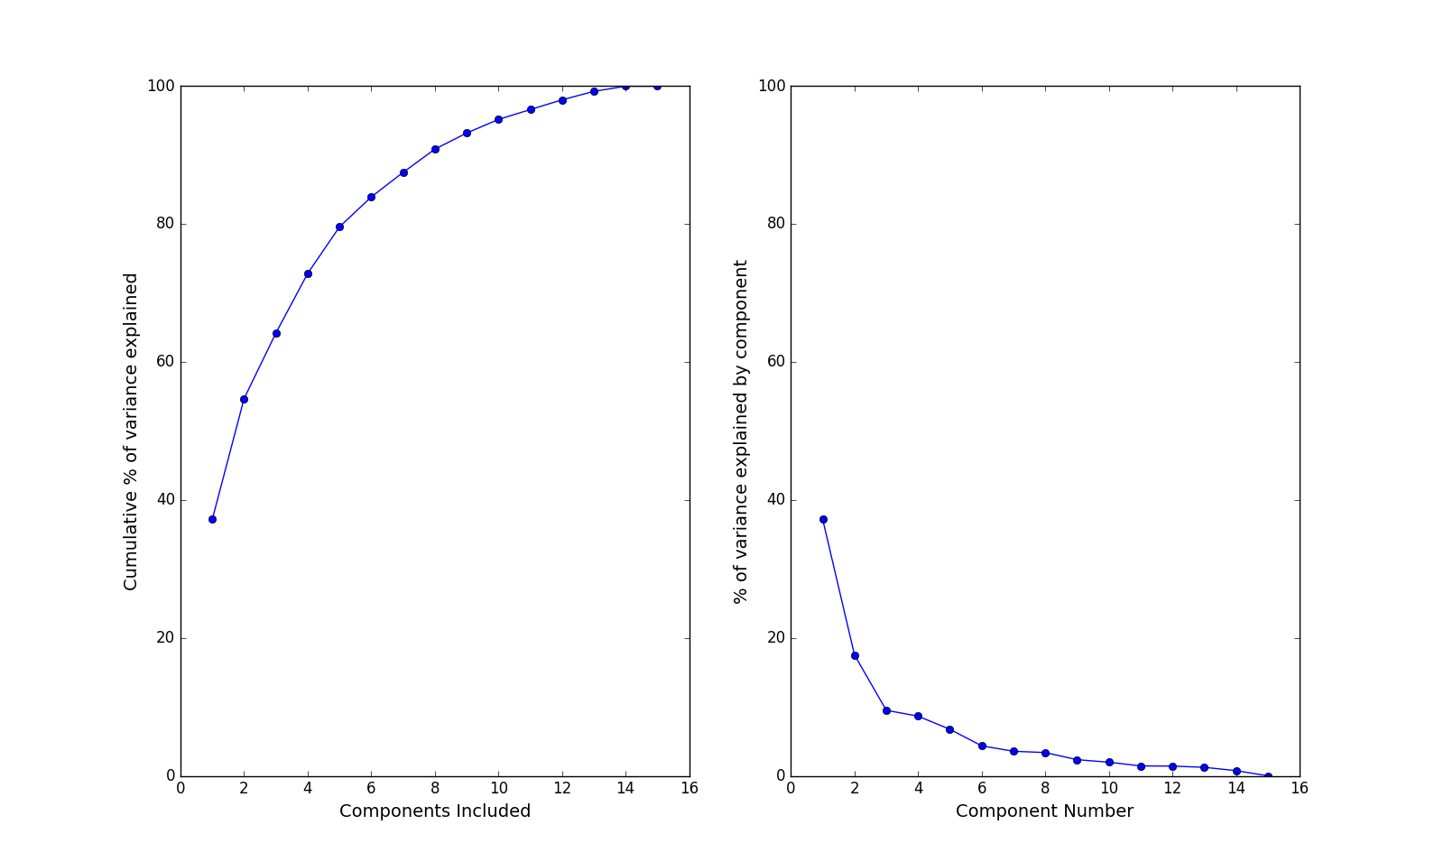
Player Data: Feature Reduction and First Clustering Attempt
Notes:
To get started...
Features can be reduced to 13 eigenvectors with PCA off the bat, with virtually no loss in information.
The graph on the right is the full set of points displayed in the top three eigenvectors, which represent 65% of the total variance in the data set, with K=3 kmeans clusters layered on the data.
Generally, Kmeans has trouble dealing with clusters of different densities and centroid placement is very sensitive to outliers. and over or under representation of clusters in some regions. Predicated on assumption that the data naturally clusters spherically which doesn’t seem to be the case here, beyond the three large clusters.

Slide 4
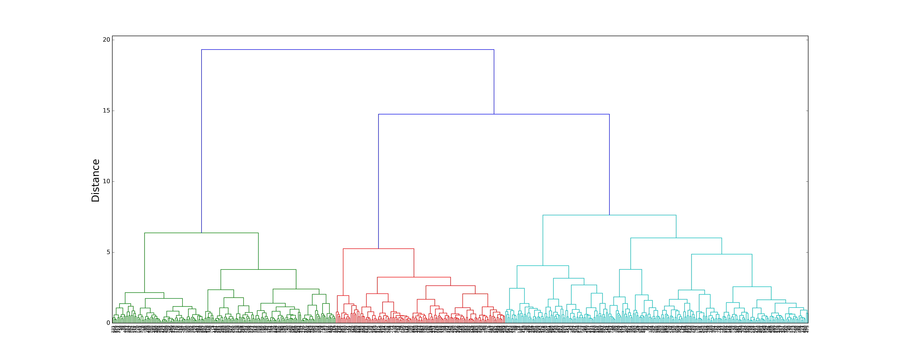
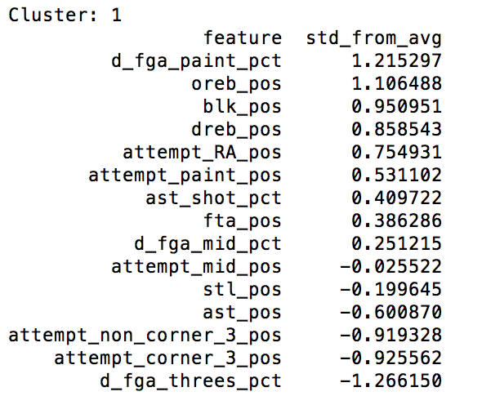
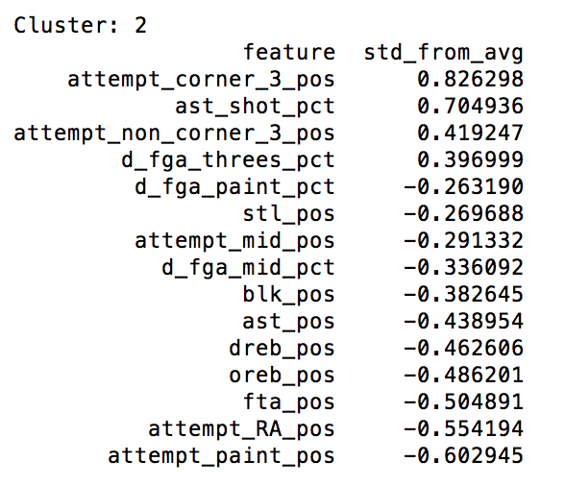
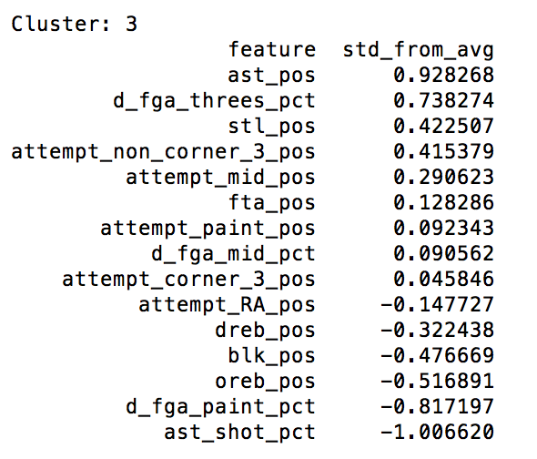
Hierarchical Structure?
Under-the-Basket Players (177)
Perimeter shooters/defenders (187)
Distributors and shot creators (203)
Notes:
ASSUMPTION OF HIERARCHY
I did assume that there was at least some hierarchical structure to the data.
Eg: 7 footers generally defend close to the basket, relatively short players generally have certain offensive skills that offset their defensive liabilities,
EVIDENCE
I applied hierarchical clustering with ward method to test this and the results supported what I saw with kmeans:
1) there is a hierarchy but the points within each of the three large clusters were difficult to subdivide using methods that optimize for distance from a centroid.

Slide 5
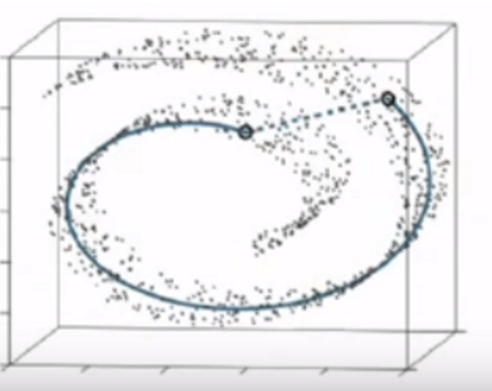
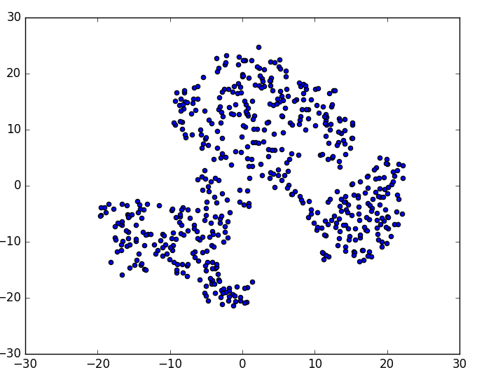
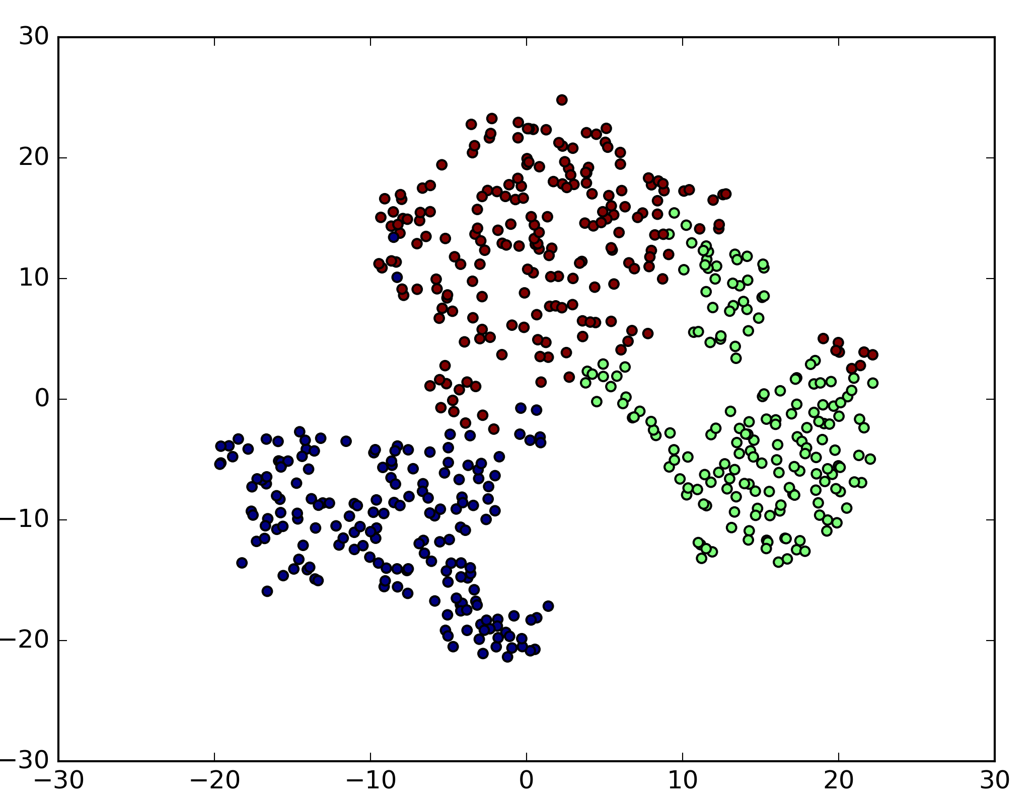
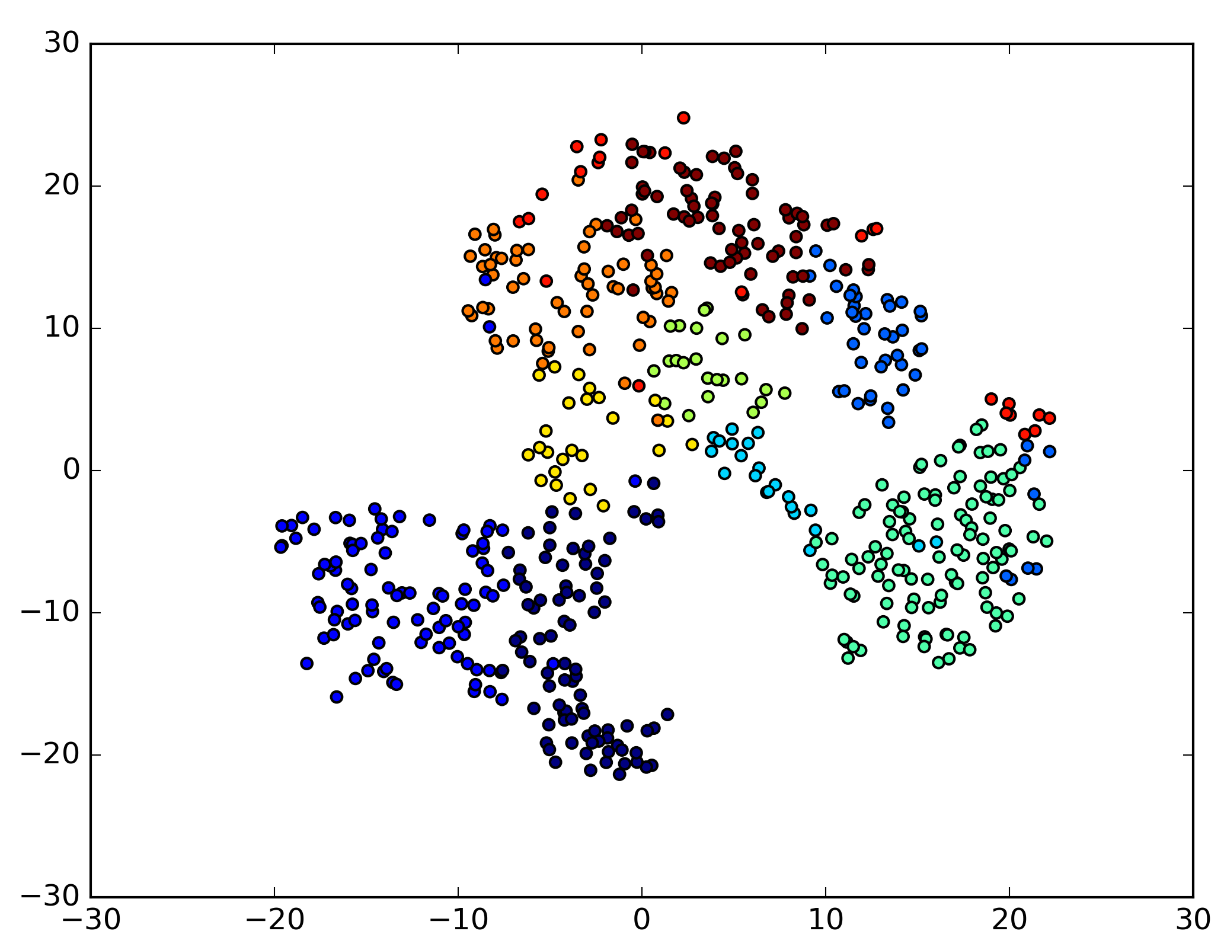
t-SNE
t-SNE example
Full data set reduced to two dimensions
3 Hierarchical Clusters Overlaid
10 Hierarchical Clusters Overlaid
Notes:
t-sne (t-Distributed Stochastic Neighbor Embedding)
technique to re-map all points in space based on a guassian method that groups points together based in their closeness to one another
rather than to a centroid in a spherical space like kmeans or hierarchical using the ward method.
optimizes preservation of small distances between points compared with PCA which tries to maximize variance ::
1) remapped points without clusters overlaid – supports a hierarhical structure
2) same data with the 3 clusters i created overlaid, supports the idea that hierarchical did well to identify these high level clusters
3) points with 10 h_clusters overlaid. also tried kmeans, shows that optimizing for min variance within clusters doesn’t work well on this level

Slide 6
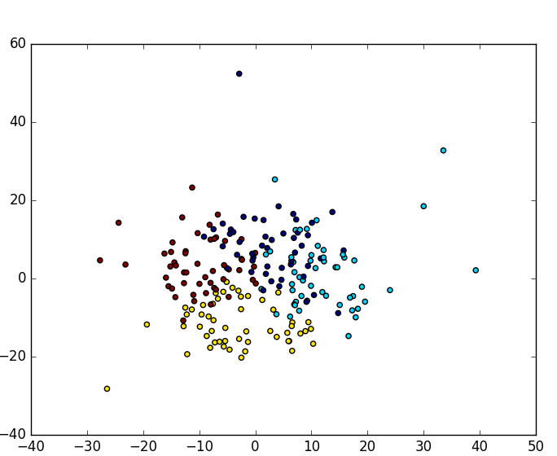
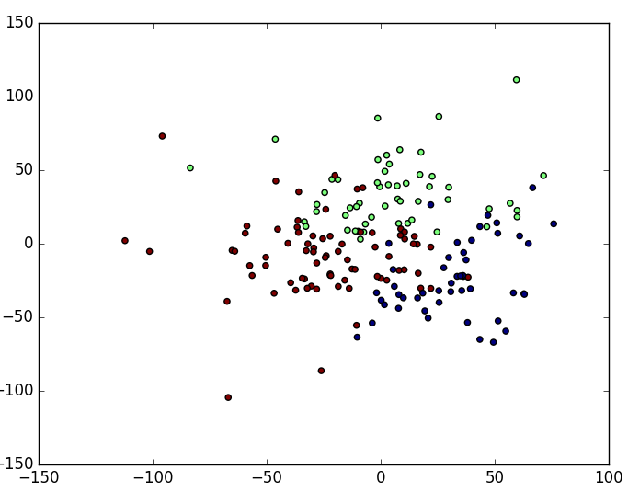
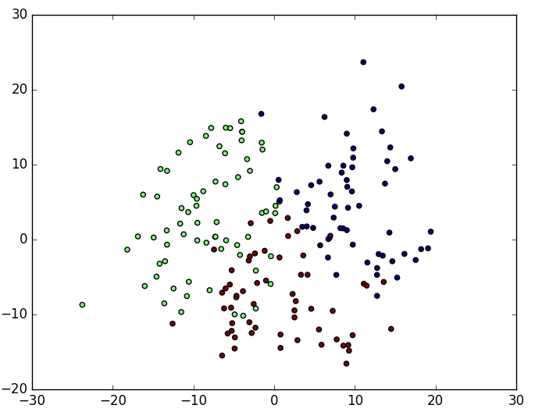
Final Clustering Step
Under-the-Basket Players (177)
0) Rim protectors, limited offense versatility (47)
1) Strong rebounders, versatile offensive skill set (53)
2) Dominant rebounders, shot blockers (77)
Perimeter shooters/defenders (187)
3) Perimeter only defenders, 3pt shooters (59)
4) 3pt shooters, volume catch-and-shoot scoring, versatile defenders (71)
5) Versatile interior and perimeter defenders, 3pt shooters (57)
Distributors and shot creators (203)
6) Ball dominant distributors and shooters (49)
7) Secondary distributors, perimeter defenders, versatile scorers (49)
8) Perimeter defenders, mid-range and three shooters, distributors (54)
9) Pure creators/distributors (51)
Notes:
took the three hierarchical clusters I created and, for each:
significantly reduced the dimensions with PCA. 15 to 5-7 while retaining 85-95% of the information
re-maped the data using t-sne
applied Kmeans on the remapped data.

Slide 7
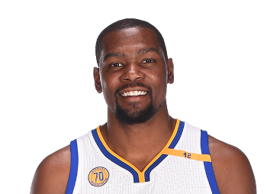
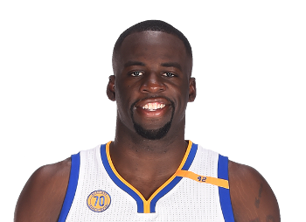
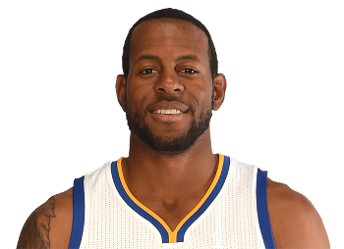
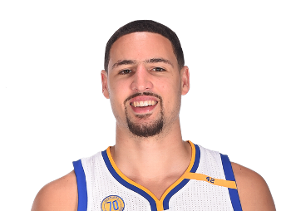
Lineup Example
lineup: Curry,Stephen - Durant,Kevin - Green,Draymond - Iguodala,Andre - Thompson,Klay
clusters: 6,7,2,4,4
points scored: 206.7
points allowed: 157.3
minutes played: 67.6
net per min: 0.7308
Notes:
I also scraped lineup performance data going back to 2012.
For every 5 man lineup that has played together we can use their aggregate points scored and their aggregate points allowed to to get their total net scoring margin, We can then standardize by minutes per minute, and use net per minute as a metric to compare lineups to one another.
After the player clustering step, we can overlay clusters on top of this lineup data in order to create samples of every combination of clusters representing lineups.
I’ll come back to this.

Slide 8
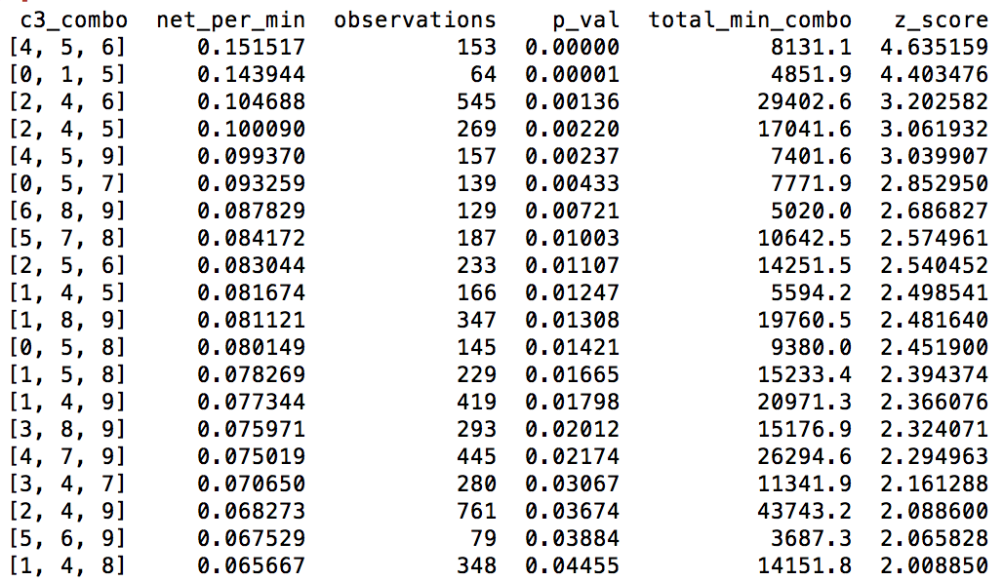
3 cluster combo performance results
Top cluster combo: 4,5,6
4 = 3pt shooters, volume catch-and-shoot scoring, versatile defenders
5 = Versatile interior and perimeter defenders, 3pt shooters
6 = Ball dominant distributors and shooters
Critical player types
4s appear in 10 of the top 20 combos
5s appear in 9 of the top combos
9s appear in 8 of the top combos
Best guess: shot creation and three point shooting are the highest value skill sets
Underrepresented player types
3s only appear in 2 of the top combos
0s only appear in 3 of the top combos
Best guess: 3s have limited defensive versatility (rarely leave the perimeter) and 0s have limited offensive versatility (rarely leave paint)

Slide 9
Next Steps
More data!
Test Gaussian Mixture model
Applications: team-by-team recommendations, projection of player type and NBA comps for rookies or college players

